Slide 1
CAP444 OBJECT ORIENTED PROGRAMMING USING C++
Lecture 4
CONSTRUCTORS AND DESTRUCTORS

Slide 2
Constructors: types of constructors
A special method which is used to initialize the object
It is automatically called when an object of a class is created.
it has the same name as the class name.
it is always public
it does not have any return type

Slide 3
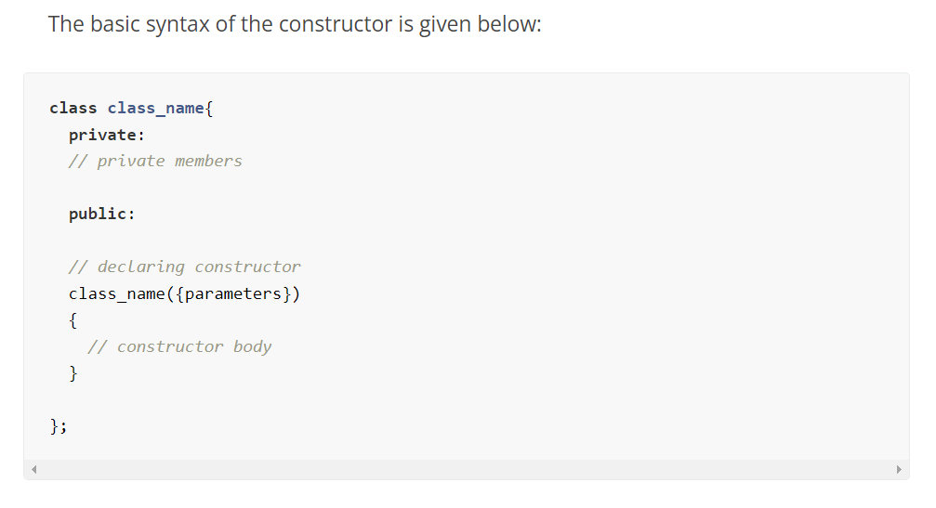

Slide 4
Types of constructor:
Default constructor
Parameterized constructor
Copy constructor

Slide 5
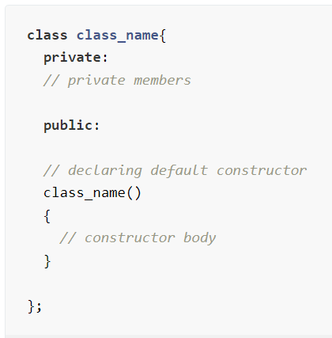
Default constructor
A constructor which has no argument is known as default constructor. It is invoked at the time of creating object.
class Employee
{
public:
Employee()
{
cout<<"Default Constructor"<<endl;
}
};

Slide 6
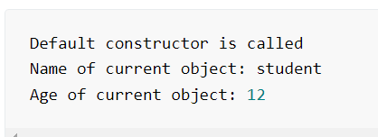
#include <iostream>
using namespace std;
class Person{
// declaring private class data members
private:
string name;
int age;
public:
// declaring constructor
Person()
{
cout<<"Default constructor is called"<<endl;
name = "student";
age = 12;
}
// display function to print the class data members value
void display()
{
cout<<"Name of current object: "<<name<<endl;
cout<<"Age of current object: "<<age<<endl;
}
};
int main()
{
// creating object of class using default constructor
Person obj;
// printing class data members
obj.display();
return 0;
}

Slide 7
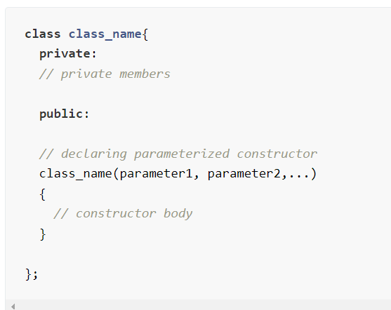
Parameterized constructor
A constructor which has parameters is called parameterized constructor.
class Employee
{
int empId;
string empName;
public:
Employee(int id, string name)
{
empId=id;
empName=name;
}
};

Slide 8
Person(int person_age)
{
cout<<"Constructor to set age is called"<<endl;
name = "Student";
age = person_age;
}
Person(string person_name, int person_age)
{
cout<<"Constructor for both name and age is called"<<endl;
name = person_name;
age = person_age;
}
// display function to print the class data members value
void display()
{
cout<<"Name of current object: "<<name<<endl;
cout<<"Age of current object: "<<age<<endl;
cout<<endl;
}
};
#include <iostream>
using namespace std;
class Person{
// declaring private class data members
private:
string name;
int age;
public:
// declaring parameterized constructor of three different types
Person(string person_name)
{
cout<<"Constructor to set name is called"<<endl;
name = person_name;
age = 12;
}

Slide 9
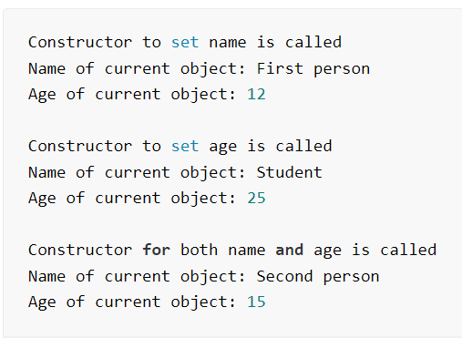
int main()
{
// creating objects of class using parameterized constructor
Person obj1("First person");
// printing class data members for first object
obj1.display();
Person obj2(25);
// printing class data members for second object
obj2.display();
Person obj3("Second person",15);
// printing class data members for third object
obj3.display();
return 0;
}

Slide 10
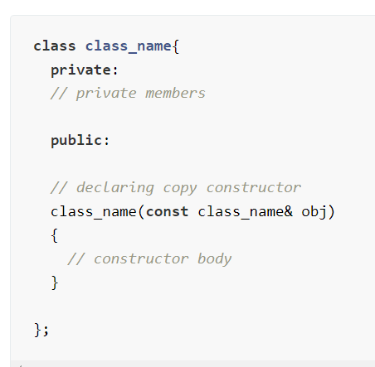
Copy Constructor
Copy Constructor is a type of constructor which is used to create a copy of an existing object of a class.
A copy constructor is a member function that initializes an object using another object of the same class.
Syntax:
class-_name(class_name & object_name)
{
}
To call this: class_name obj1(arguments);
class_name obj2 = obj1;

Slide 11
#include <iostream>
using namespace std;
class Person{
// declaring private class data members
private:
string name;
int age;
public:
Person(string person_name, int person_age)
{
cout<<"Constructor for both name and age is called"<<endl;
name = person_name;
age = person_age;
}
Person(const Person& obj)
{
cout<<"Copy constructor is called"<<endl;
name = obj.name;
age = obj.age;
}
// display function to print the class data members value
void display()
{
cout<<"Name of current object: "<<name<<endl;
cout<<"Age of current object: "<<age<<endl;
cout<<endl;
}
};

Slide 12
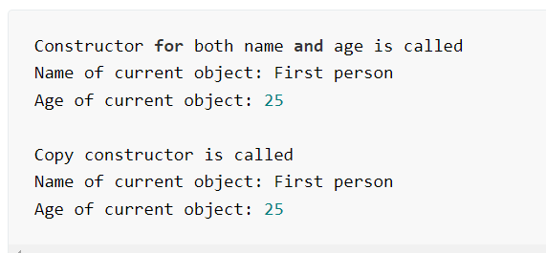
int main()
{
// creating objects of class using parameterized constructor
Person obj1("First person",25);
// printing class data members for first object
obj1.display();
// creating copy of the obj1
Person obj2(obj1);
// printing class data members for second object
obj2.display();
return 0;
}

Slide 13
Destructor
Destructor is a special member function which destructs or deletes an object.
A destructor is called automatically when object goes out of scope.
Destructors have same name as the class preceded by a tilde (~)
Destructor should not have any parameter
There can only one destructor in a class
When a class contains a pointer to memory allocated in class, we should write a destructor to release memory

Slide 14
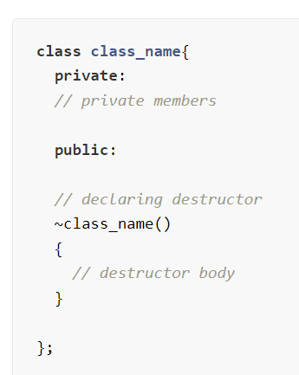

Slide 15
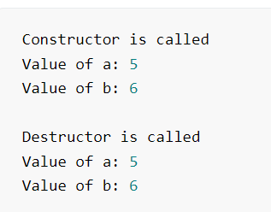
#include <iostream>
using namespace std;
class class_name{
// declaring private class data members
private:
int a,b;
public:
// declaring Constructor
class_name(int aa, int bb)
{
cout<<"Constructor is called"<<endl;
a = aa;
b = bb;
cout<<"Value of a: "<<a<<endl;
cout<<"Value of b: "<<b<<endl;
cout<<endl;
}
~class_name()
{
cout<<"Destructor is called"<<endl;
cout<<"Value of a: "<<a<<endl;
cout<<"Value of b: "<<b<<endl;
}
};
int main()
{
// creating objects of class using parameterized constructor
class_name obj(5,6);
return 0;
}

